Slide 1


Beyond the Buy Button
An operations and marketing analysis of Olist - Brazil’s leading e-commerce player
Study Group 8
AM10 AUT25 Data Visualisation and Story Telling

Slide 2


Background
Client Overview
Scenario
Brazil‘s largest online marketplace aggregator
Platform connecting small businesses to consumers
Handles logistics and delivery fulfilment via a third party
After a period of strong growth, order volume has become stagnant
As a startup, the business is struggling to achieve profitability and scale effectively
Leadership has set an ambitious internal goal to triple revenue in the next 2 years
We have been hired to analyse Olist‘s end-to-end operational data.
Objectives:
to identify the most critical levers for growth
to uncover key pain points of customers
to provide strategic recommendations

Slide 3
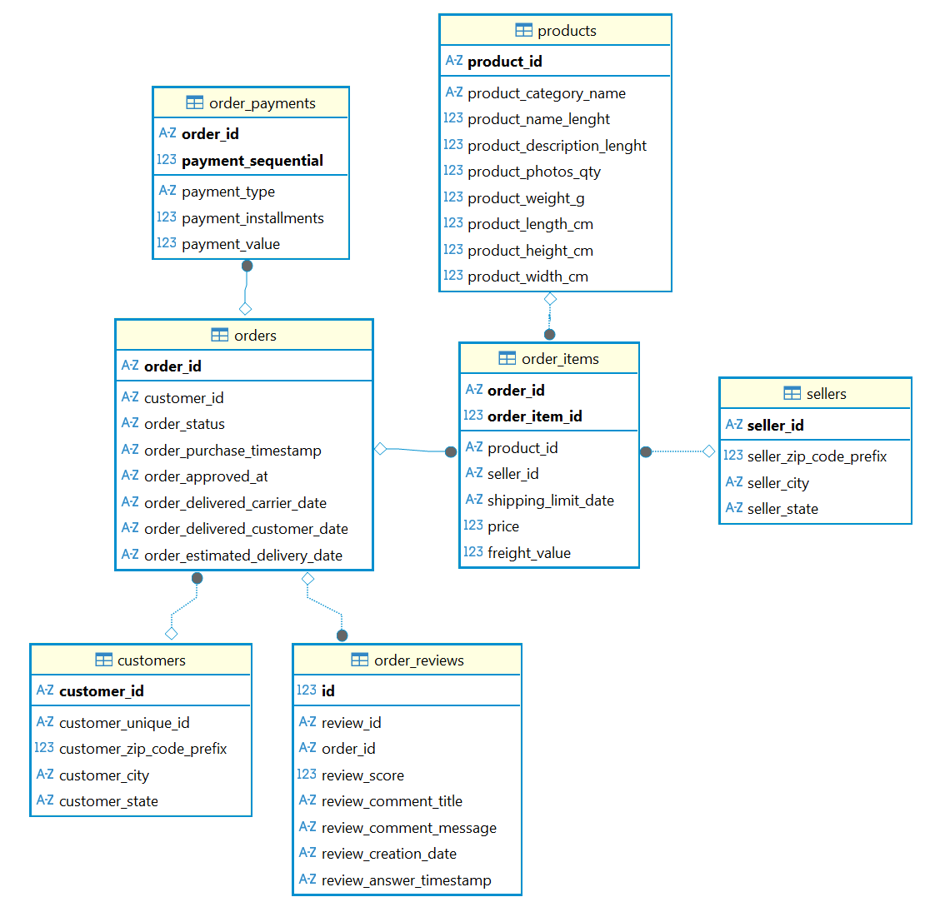
Database overview
We are analysing a comprehensive dataset (publicly provided by Olist) containing over 100,000 orders.
Methodology:
Database construction: We first structured the 7 raw data tables into a relational database using DBeaver
Data cleaning: We performed cleaning, handled missing values, and standardised data types
Focused exploration: Our analysis is predicated on three key areas for the growth mandate:
  Service quality & Customer satisfaction
  Customer purchase behaviours
  Platform ease of use

Slide 4
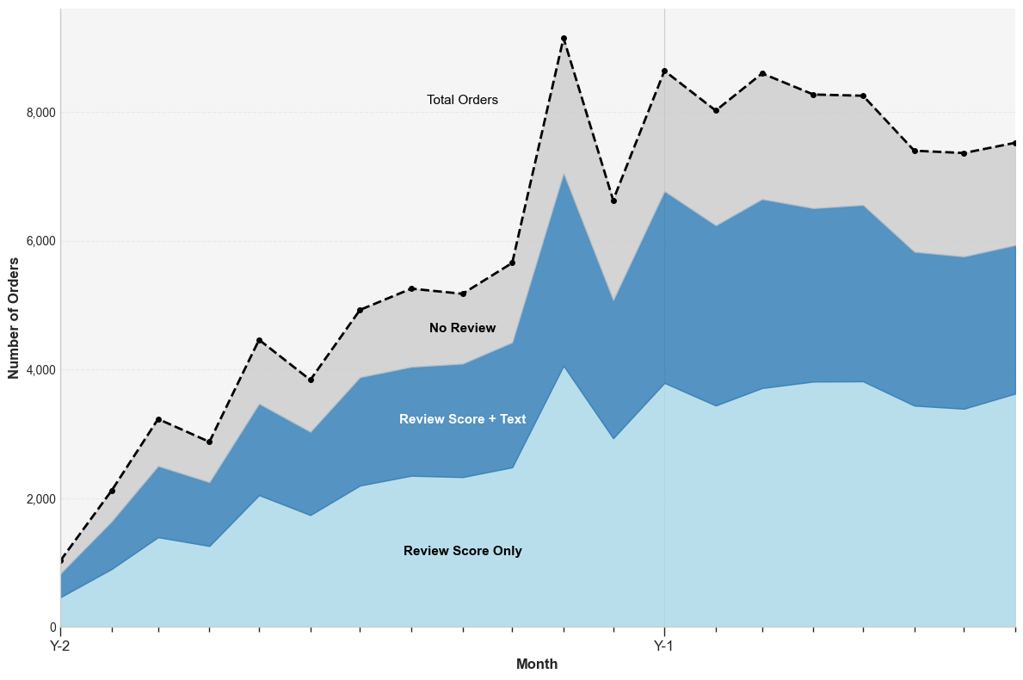
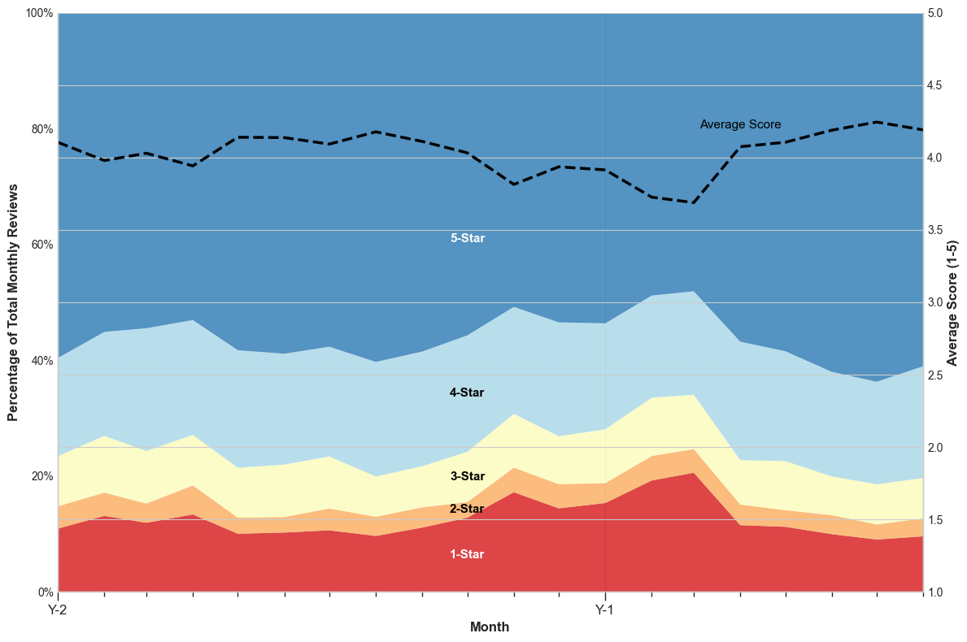
Business performance has stalled, underpinned by chronic, unresolved customer review issues
Order volume, a key growth metric, has flattened in Year 1 after a period of rapid expansion, while review collection remains efficient at ~80%.
A persistent 10-15% floor of 1-star reviews is anchoring the average score at a mediocre ~3.8 stars, preventing any upward improvement.
Orders by review activity over time
Review scores over time

Slide 5
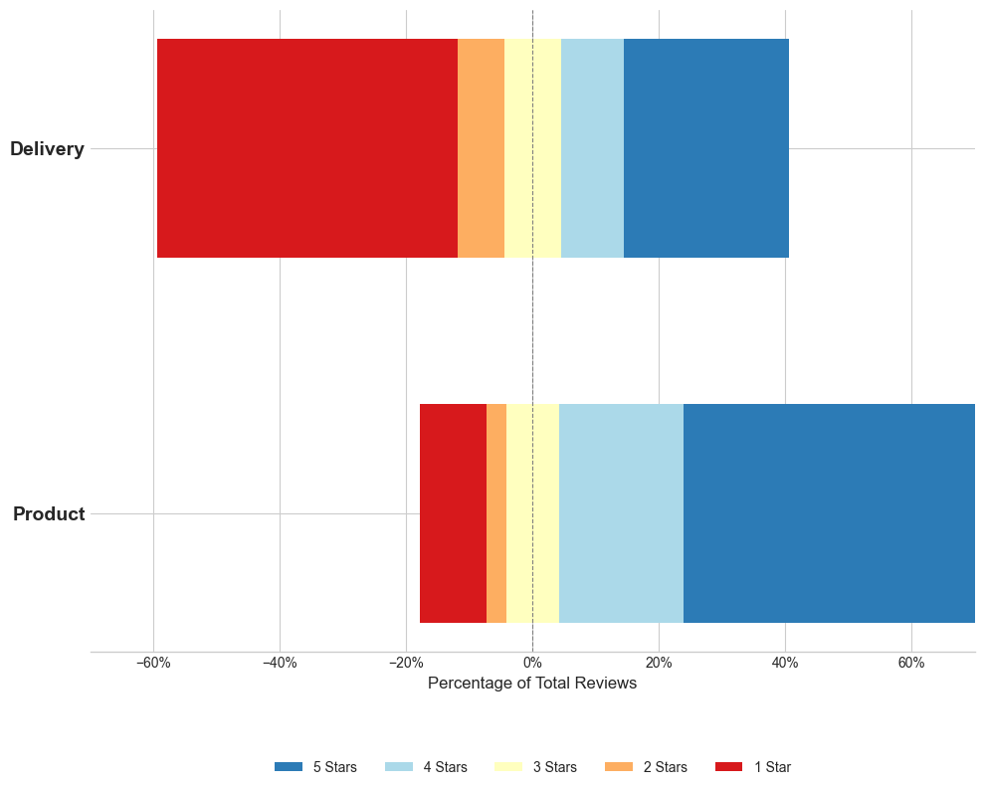
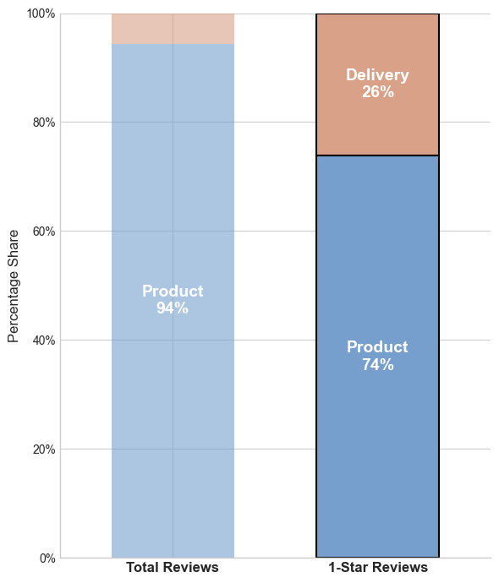
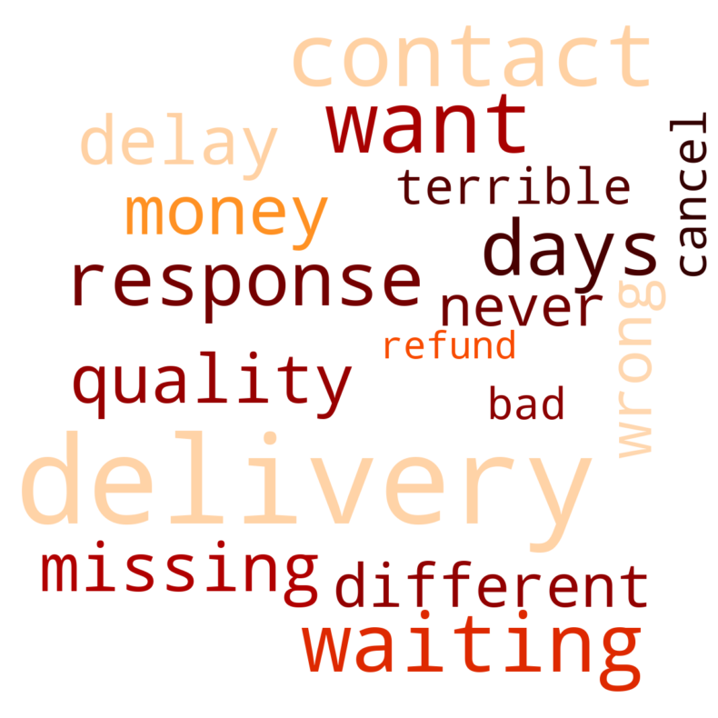
A deep dive into review data pinpoints logistics, not product quality, as the primary driver of negative customer experiences
Product reviews are generally positive, but delivery reviews are dramatically skewed negative.
Delivery issues are disproportion-ately responsible for 1-star ratings.
A qualitative keyword analysis of all 1-star comments confirms this.
Review scores by review type
Share of delivery reviews by score
Common keywords for 1-star reviews
Delivery reviews = reviews given within 1 day of delivery

Slide 6
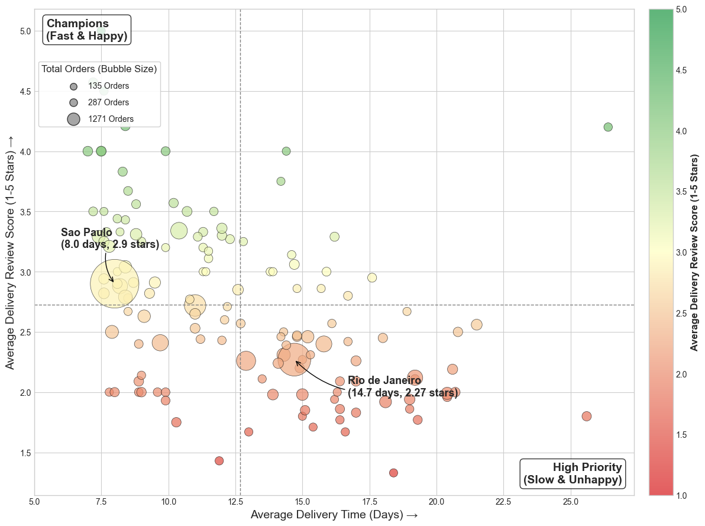
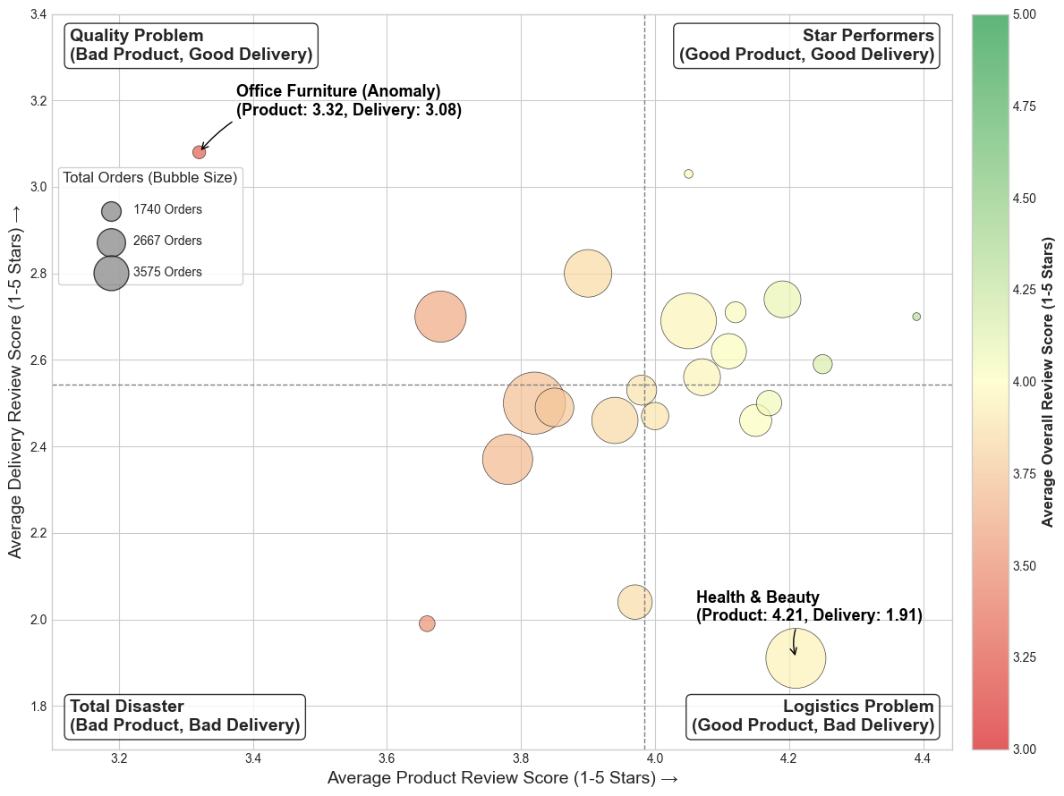
The logistics problem is not uniform, allowing for a targeted, regional intervention in high-priority cities
Performance by city varies dramatically: Especially key market Rio de Janeiro stands out as a high-volume, low-performance outlier.
Category-level analysis reveals distinct problems: Office furniture suffers from a product quality issue, while health & beauty has a severe logistics crisis.
Delivery reviews over average delivery time by customer city
Delivery reviews over product reviews by product category

Slide 7
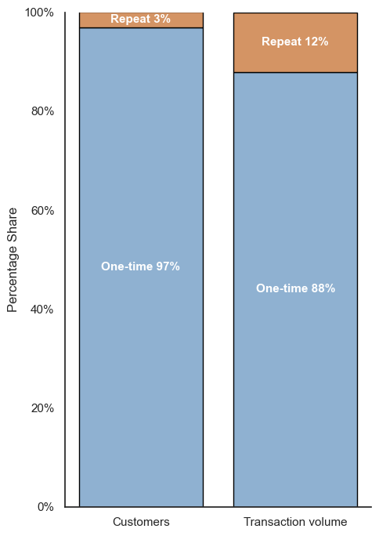
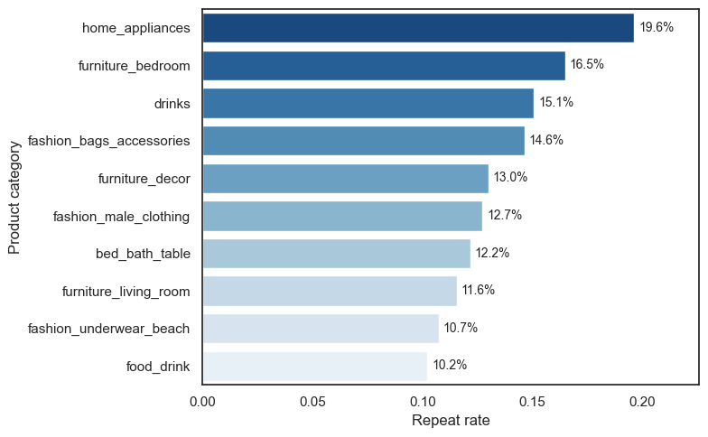
Repeat purchases are extremely rare on Olist - but the few repeat customers come from specific high-loyalty categories
Although 97% of customers purchase only once, the 3% who return contribute 12% of total transaction volume.
Repeat behaviour is highly uneven across categories. These stable-need categories drive most repeat purchases, highlighting that not all categories offer the same retention potential.
Share of repeat customers and transaction volume
Top product categories by repeat rate

Slide 8
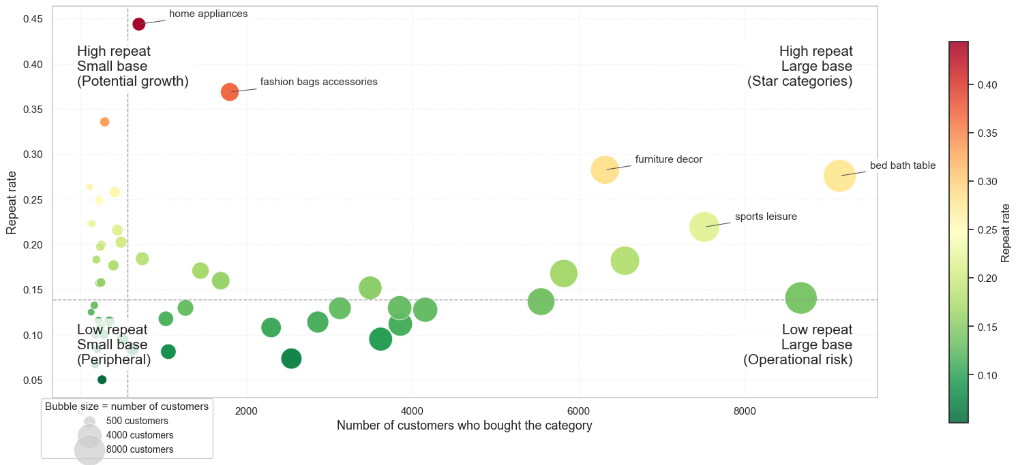
Category-level repeat behaviour analysis reveals four unique strategic segments that will need targeted attention
Based on repeat patterns we can divide categories into four groups that require distinct marketing strategies. High-repeat but small-base categories offer the greatest potential for growth.
Repeat Behaviour vs Customer Base by Category

Slide 9
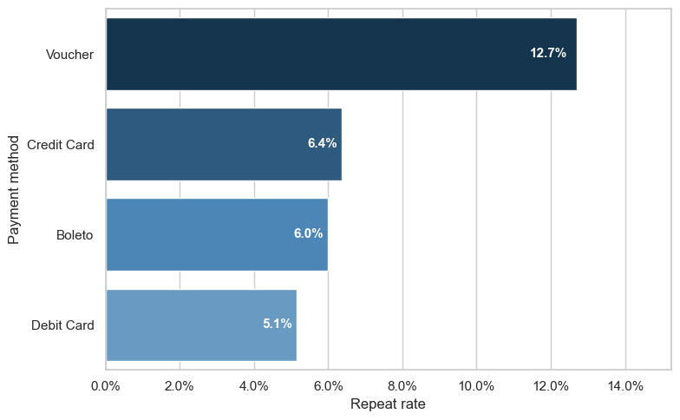
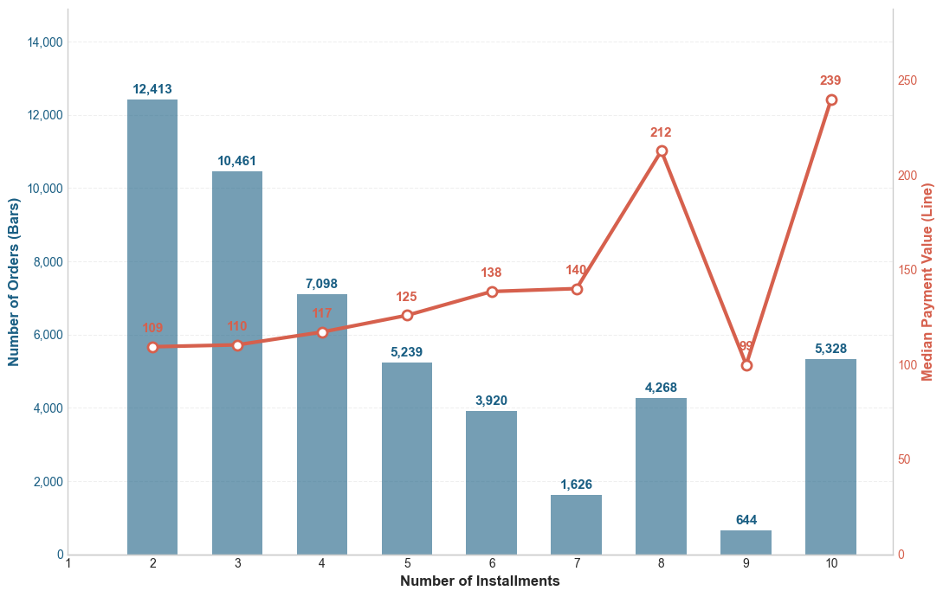
Customer loyalty varies sharply by payment behaviour, obscuring the true drivers of repeat purchases
Payment methods attract different customer segments: Voucher and credit-card users stand out for their meaningfully higher repeat rates.
Significant usage of the current 10-installment option indicates interest in higher numbers of instalments, unlocking high value orders.
Repeat rate by payment method
Payment value vs number of credit instalments

Slide 10
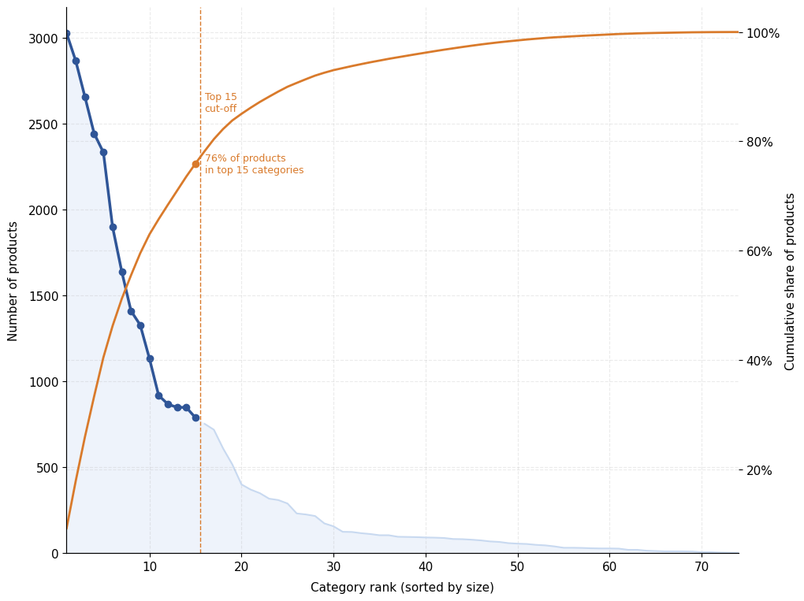
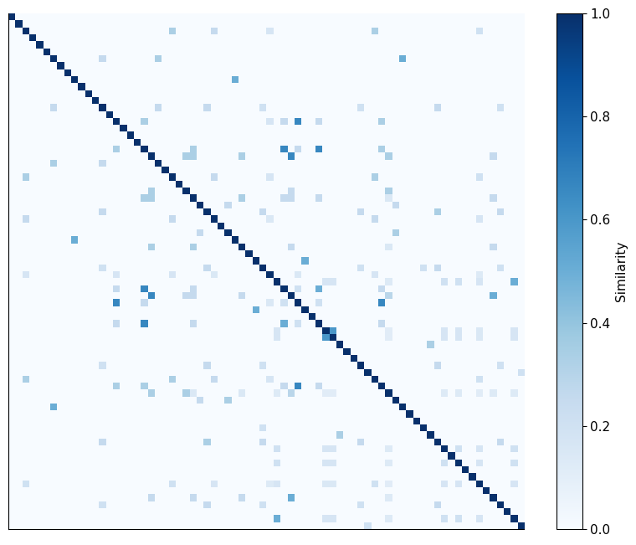
A highly fragmented and inconsistent category system obscures true product performance
An uncontrolled category system: a long tail of tiny categories and inconsistent naming makes systematic analysis impossible.
The heatmap shows many overlapping or duplicated category names, making it difficult to group products reliably and undermining category-level analysis.
Long-tail distribution of product categories
Category name similarity heatmap

Slide 11



STRATEGIC RECOMMENDATIONS
  Switch delivery partners or engage providers in underperforming regions.
  Introduce a priority delivery option for health & beauty products.
  Conduct surveys to identify issues with furniture products.
  Conduct surveys to identify issues with furniture products.
  Invest in categories with high repeat purchase rate but low penetration.
  Use vouchers and cross-category recommendations to incentivise repeat purchases.
  Create a distinct category hierarchy to ease navigation.
  Standardise naming to reduce confusion and improve search accuracy.
  Separate delivery and product reviews to improve clarity on true product quality.
Service quality & customer satisfaction
Customer purchase behaviours
Platform ease of use
Discussion & Critique
We learned that high-quality analysis relies on clean, consistent data. Fragmented categories, missing delivery timestamps, and sparse repeat-purchase samples introduced noise and limited some insights. Going forward, we would prioritise earlier data cleaning, clearer documentation, and stronger validation. Future students should expect that most challenges come not from modelling, but from preparing and understanding the data.

